Slide 1


Budget Sales Analysis

Slide 2
Problem Statement:
Our "Domain Sale" process is structured to help potential buyers purchase the domain
they want immediately without the hassle of contacting the seller directly.
A seller lists a domain for sale at a specific price in our Marketplace. An interested buyer sees this domain for sale and decides to buy it.

Slide 3
Objectives:
• The collection includes records for sales orders, customer information, product information, and geographical data.
• In order to deduce important metrics and patterns in the dataset, this project will use the provided data to perform ETL and data analysis.
• Additionally, several visualizations and reports are created to represent significant linkages

Slide 4
Benefits:
• Help in making wiser business decisions.
• Greater client base understanding is provided.
• Facilitates seamless resource management flow.
• Aid in customer satisfaction and trend monitoring, which can serve current consumers and attract new ones.

Slide 5
Details of Data:
Customer Key: Primary key for customer dataset
Birthdate: Birthdate of the customer
Marital Status: M- Married / S - Single
Gender: M – Male / F – Female
Total Children: Total number of children
Number Children At Home: Number of children staying along with their parents
Education: Education qualification
Occupation: Present occupation
House Owner Flag: 1– Owns house / 0- Doesn’t have a permanent address
Number Cars Owned: Number of cars owned by the customer
Date First Purchase: First date of order by the customer
Product Key: Primary Key for the product dataset
Product Name: Product name with colour of the product

Slide 6
Details of Data:
Subcategory: Sub category name of the product
Category: Category name of the product
List Price: Sale price of the product
Days To Manufacture: Days to manufacture the product after receiving the order
Product Line: Product line name
Model Name: Model name of the product
Product Description: more details about the product
Sales Territory Key: Primary Key of the Territory dataset
Region: Region name of the order
Country: Country name of the order
Order Date: Date of the order received

Slide 7
Details of Data:
Ship Date: Date when the order left the factory for export
Sales Order Number: Invoice number of the order
Order Quantity: Number of quantities ordered for a product
Unit Price: Per unit sale price of the product
Total Product Cost: Cost of the product
Sales Amount: Total sales price of the product
Tax Amt: Tax collected for the product sold

Slide 8
Architecture:
Collect Raw Data → Importing Libraries → Load Dataset → Merging Data → Assessing Data → Handling Missing Data → Adding Columns → Exploring Data → Modeling → Creating Measures → Tableau Report → Insights

Slide 9
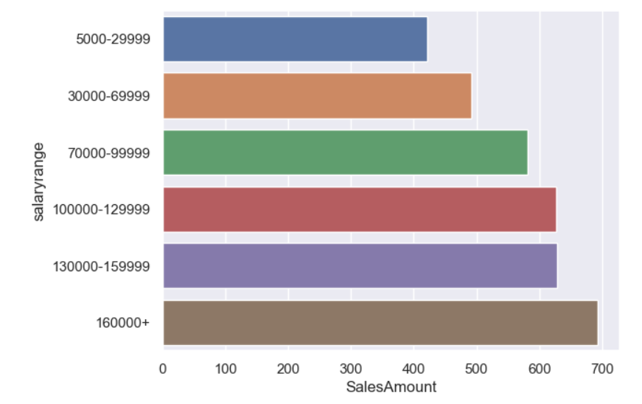
Some Important Insights:
1. Yearly income range and purchase correlation
>High salary range leads to increase in revenue

Slide 10
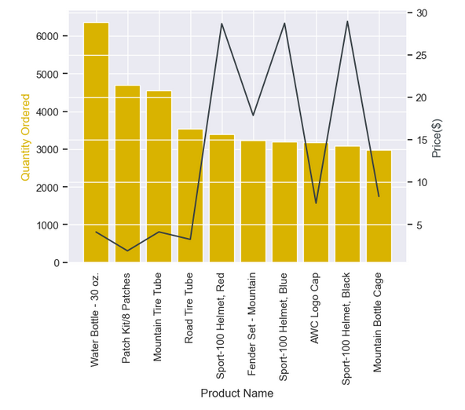
Some Important Insights:
2.Which product sold the most? why do you think it sold the most?
▪ There is a high negative correlation between Price and number of Quantity ordered
▪ we can conclude that low price product has high demand

Slide 11
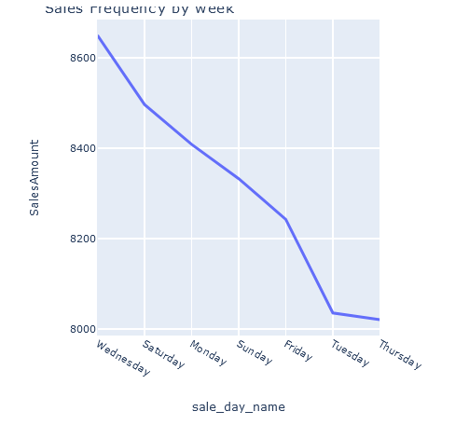
Some Important Insights:
3. What time should we display advertisement to maximize likelihood of customer is buying product?
> High sales orders are seen on Wednesday and Saturday; therefore, we can promote our product during these workweek

Slide 12
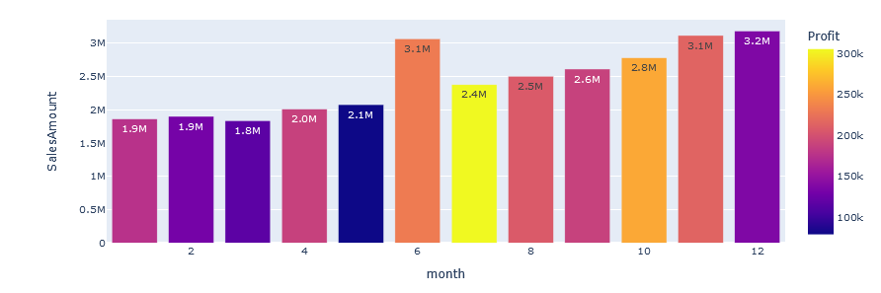
Some Important Insights:
4. What was the best month for sales? How much was earned that month?
> Maximum profit earned in the months of June, November, and December

Slide 13
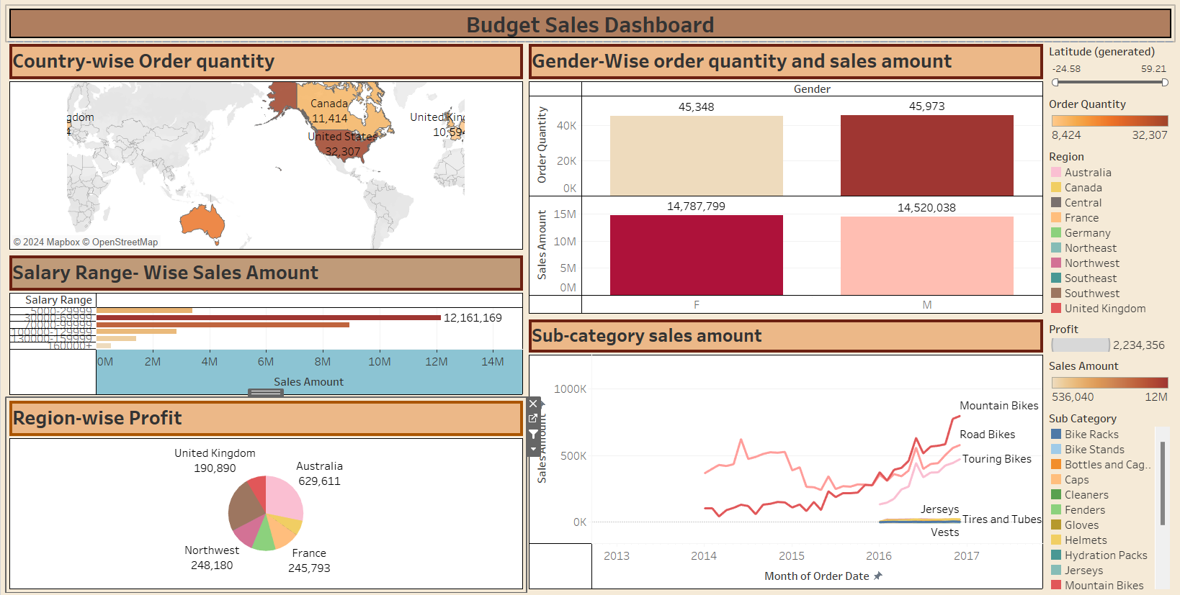
Dashboard:

Slide 14
Key Performance Indicator:
▪ Sales trend line
▪ Cost trend line
▪ Average unit cost and price
▪ Revenue generated by Subcategory
▪ Sales by Product Line
▪ Revenue contribution by region
▪ Profit contribution by region
▪ Profit % by region
▪ Current year profit margin vs difference in last year’s profit margin
▪ Total orders ▪ Total revenue
▪ Variance to target comparison by category
▪ Variance by month line chart
▪ Actual sales and target sales matrix
▪ Cohort analysis table
▪ Customer retention line chart
▪ Monthly spending trend
▪ Average monthly spend distribution

Slide 15
Conclusion:
▪ A sizable portion of the clientele is made up of people between the ages of 40 and 59
▪ The year 2016 saw an exponential surge in sales
▪ High quantity of products is ordered from Australia and United States
▪ Major Profit is contributed by the Bike Category
▪ The average order has a gap of 7 days between the day the order is ready for export from the factory and the date it was shipped
▪ Maximum profit earned in the months of June, November, and December
▪ High sales orders are seen on Wednesday and Saturday, when compared to other weekdays
▪ There is a high negative correlation between Price and number of Quantity ordered

Slide 16
Conclusion:
▪ The average amount spent by men without permanent addresses is low, whilst the average amount spent by women without permanent addresses is higher
▪ Age range of 40-49 and 50-59 is shows high demand compared to other age group
▪ High salary range leads to increase in revenue
▪ Customers with a high school diploma and modest annual income buy more products than people with bachelor's degrees
▪ According to the customer segmentation described above, approximately 15% of our clients are high value clients, whereas the majority of our clientele are low value and lost clients
▪ Client retention in 2014 was subpar
▪ 2016 brought about a slight improvement in retention

Slide 17


Thank You.

